Slide 2
SOURCES OF DATA AND INFORMATION
Primary Source
  Those which are collected as fresh and for the first time and thus happen to be original in character and known as Primary data.
Secondary Source:
  When you gather information from existing sources, you are looking for already published information that can cast light on questions you are asking. This is called secondary source because you are investigating the research that others have already done.

Slide 3
RESEARCH METHODS
Source of data and information
Use of Library
Survey
Questionnaire
Group Discussion
Interview
Summarizing and Outlining

Slide 4
CONDUCTING A SURVEY
Supports practical decision making
Gather information from groups of people
Example: Manufacturers survey of customers for new product

Slide 5
STEPS FOR CONDUCTING SURVEY
Survey can be conducted on the basis of:
  Writing the questions
  Contacting respondents
  Selecting respondents

Slide 6
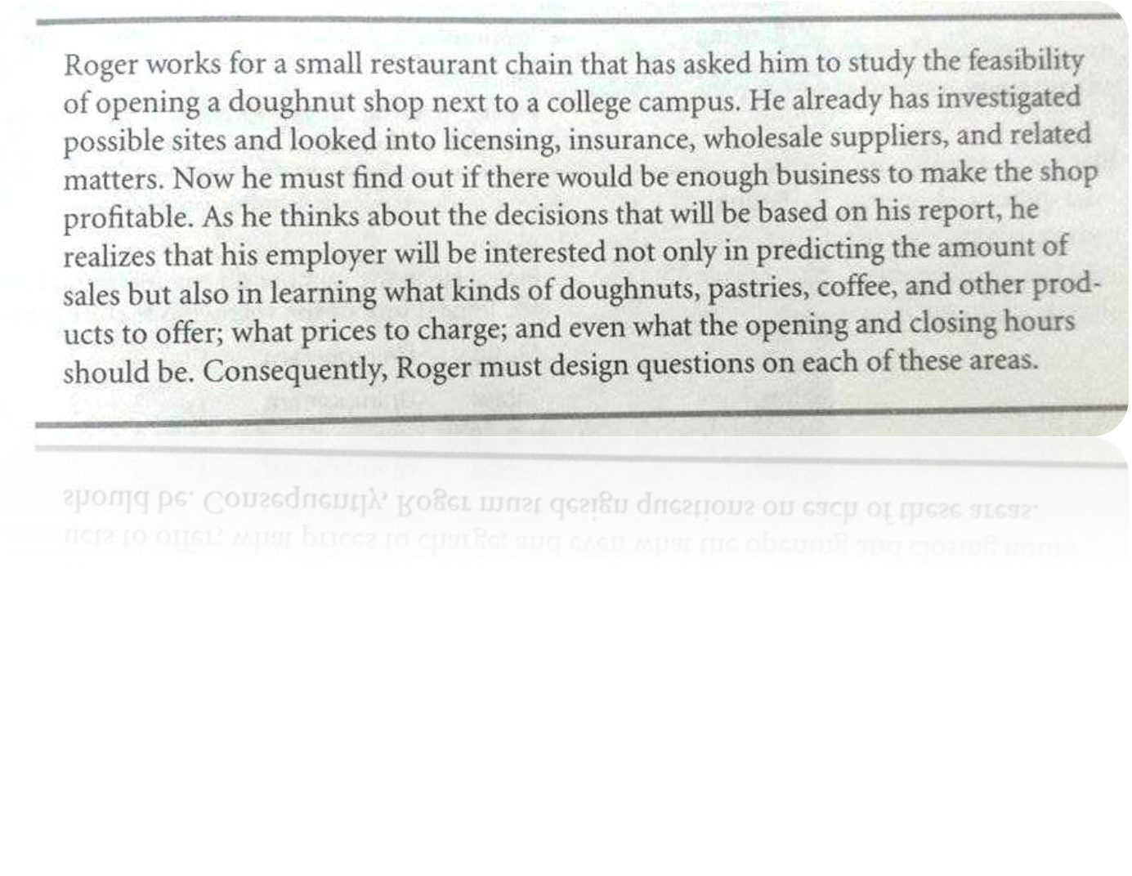
WRITING THE QUESTIONS
Focus on decision
Questions based on decision needed to be taken

Slide 7
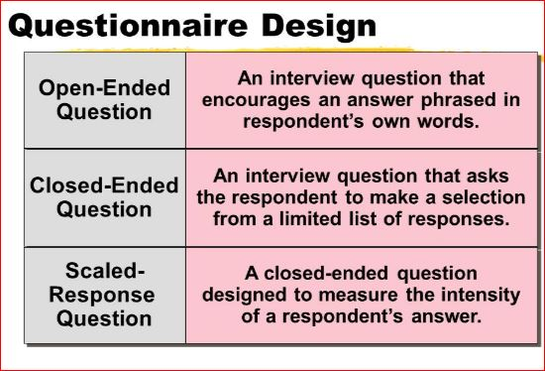

Slide 8
STRUCTURED QUESTIONS(CLOSE ENDED)
Limited number of possible answers.

Slide 9
YES/NO QUESTIONS
  Do you have a membership card?
    Yes( )
    No ( )

Slide 10
MULTIPLE CHOICE QUESTIONS
  For what purpose do you visit the library?
    To read news papers
    To brows internet
    To read books

Slide 11
SCALED QUESTIONS
Please mark an X on the scale to indicate how you perceive the textures of this ice cream.
Too light Light Creamy Too creamy

Slide 12
UNSTRUCTURED(OPEN ENDED QUESTIONS)
What facilities and services do you expect from this library?
_________________________________________ _________________________________________ _________________________________________ _________________________________________

Slide 13
GUIDELINES
Ask Reliable Questions
-understood and interpreted in the same way
-For example, if Roger asked, “Do you like high-quality pastries?”, different readers might interpret the term “high-quality” in different ways.

Slide 14
GUIDELINES
1. Ask Valid Questions
  - Produces information required
  - For example, to determine how much business the doughnut shop might attract, Roger could ask either of these two questions:
  1. How much do you like doughnuts?
  2. How many times a month would you visit a doughnut
  Shop located within three blocks of campus?

Slide 15
CONTINUED…
The first question is invalid because liking a doughnut does not necessarily mean that they would come frequently
The second question is valid because it can help Roger estimate how many customers the shop would have.
4. Avoid Biased Questions
  - guiding respondents to give particular response

Slide 16
CONTINUED…
  1. Wouldn’t it be good to have a coffee shop near campus? ( Biased)
2. How much would you like to have a coffee shop near the campus? (Unbiased)
5. Most Interesting Questions Placed First
- questions about age etc at the end
6. Limit the Number of Questions
7. Test the Questionnaire

Slide 17
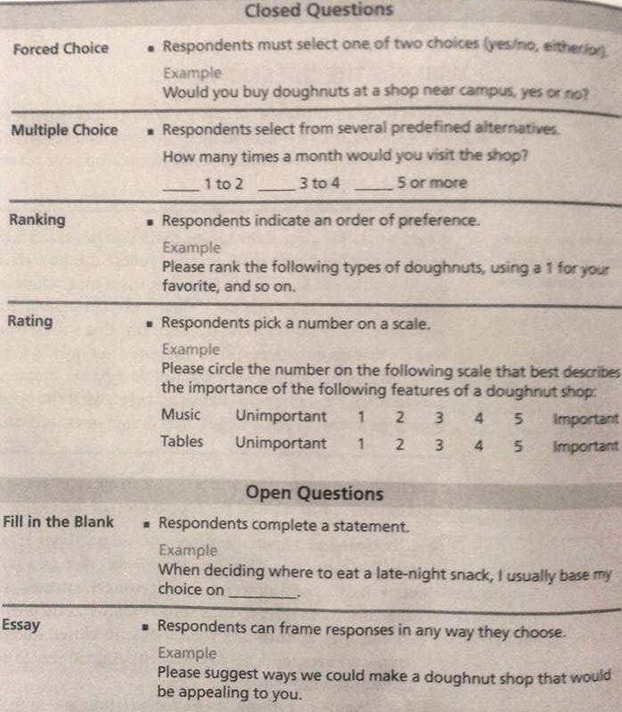

Slide 18
CONTACTING RESPONDENTS
Face to Face
- Read questions aloud to each respondent
- More cooperation on the part of respondents
- Risk of intonation, facial expression or body language
Telephone
  - Convenient
Mail or Handout
- Less time consuming than face to face method
- Only filled by a small portion of people
  ONLINE FORMS

Slide 19
SELECTING THE RESPONDENTS
Generalizing about a large group of people (population) by surveying only a small portion of individuals in the group (sample).
1. Simple Random Sample
  - Every member has equal chance of being chosen
  - Easy for small population

Slide 20
2. Systematic Random Sample
-Systematic random sample
-List of every member and selection through specific pattern
- For example, the third number member on every page
3. Convenience Sample
  - Selection of people who are handy
  - Risk of unreliable results

Slide 21
4. Stratified Sample
  - Dividing members into homogeneous sub-groups
  - Selection from each sub-group
  ___________________________________________
  ___________________________________________

Slide 22
INTERVIEW AND GROUP DISCUSSIONS
Best source of information at work is another person.
Asking an expert for information
Can be face to face or on telephone

Slide 23
PREPARING FOR AN INTERVIEW
Chose the Right Person to Interview
  Chose someone with knowledge about topic.
  Chose someone you are confident with.
Make Arrangements
  Contact in advance for an appointment
  Inform about the purpose
  Inform about time duration
  Ask permission for recording if needed

Slide 24
CONTINUED…
Plan the Agenda
  Decide in advance what is expected to be learnt from the interview
  Prepare a list of topics

Slide 25
CONDUCTING THE INTERVIEW
Let the other person talk most of the time
Have him focused on the information needed
Maintain a productive interpersonal relationship

Slide 26
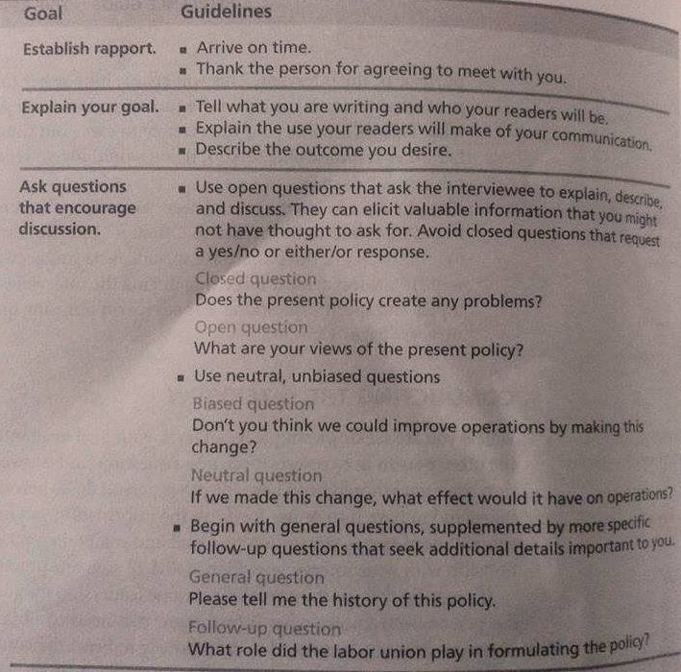

Slide 27
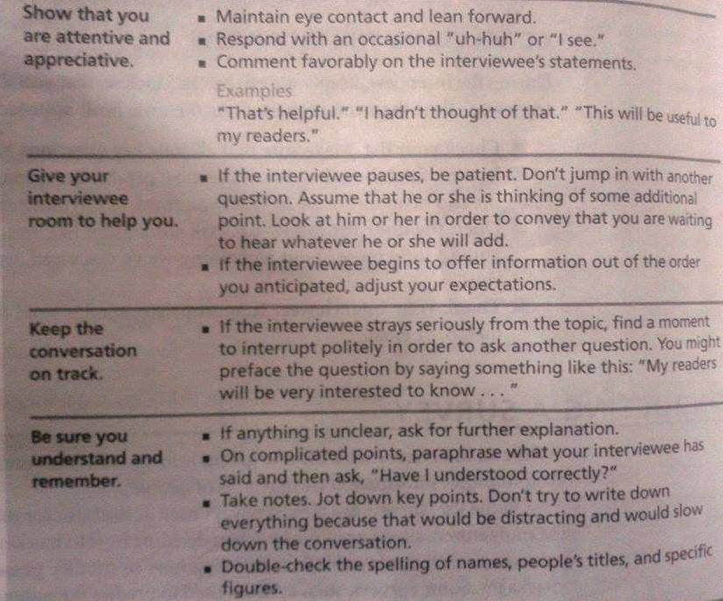

Slide 28
CONCLUDING THE INTERVIEW
Keep a check on the time limit
Make sure all questions have been answered
Invite a final thought
Open the door for follow-up, for example asking: “If I find that I need to know a little more about something we have discussed, would it be okay if I call you?
Thank him by sending a brief thank-you note by letter or e-mail

Slide 29
USE OF LIBRARY
Research Aids
  Reference Librarians
  Catalogs
Information Sources
  Online Books
  Books in print form

Slide 30
RESEARCH AIDS
Reference Librarians
  Helpful
  Gives information about specialized resources
  Explains the use of these features
Library Catalog
  List of holdings of the library ( books, periodicals, pamphlets, recordings, videotapes etc)
  Can be computerized or in print form

Slide 31
Use of Library Catalog
  Subject Search
    Search through subject
    Searched the tagged subject
  Word Search
    Search through specific key words
    Indicated entire content having that word

Slide 32
Activities on page 380 or maybe 320

